Slide 1

UrbanRide Architecture Design
Core Backend Architecture for a High-Scale Global Ride-Hailing Platform
Team
BANDARA L.H.M.M.D. – 230078B
BEDDAWALA B.G.K.P. – 230089J
BHAGYA T.G.N. – 230090E
CHATHURANGA R.M.R. – 230104E
DEWDUNIKA D.R.K.W.M.V.V. – 230135A

Slide 2
UrbanRide's architecture meets strict scale, latency, and cost targets.
Volume Target
1,000,000
Completed rides per day
Speed Target
< 500 ms
Transaction latency
Economy Target
< 10 LKR
Cost per completed ride
Resilience Architecture
Surge Capacity: System designed to absorb up to a 5× traffic surge while maintaining the target transaction latency.

Slide 3
System Ingestion Scale
Designed for massive daily volume and high-frequency GPS ingestion.
Transactional Ingestion
Low-Frequency Ride Requests
~60 req/s
Peak Volume
Average Ingestion: ~12 req/s
Standard transactional load managed via REST endpoints.
Streaming Ingestion
High-Frequency Driver Telemetry
~37,500 pings/s
Telemetry Ingestion Rate (4-second intervals)
Active Fleet at Peak: 150,000 drivers
Continuous state stream ingested directly into persistent queues.
Architectural Impact:
Telemetry volume exceeds transactional ride request volume by over 600x at peak. The stream ingestion pipeline is specifically optimized for high-throughput, low-latency GPS write workloads independent of core booking services.

Slide 4
Strict database-per-service isolation optimizes for specific workload and CAP requirements.
Service Domain
Trip & Billing
Aurora PostgreSQL
CAP Stance: CP
Financial consistency focus
Service Domain
Location Ingestion
Kafka + S3
CAP Stance: AP
High-throughput buffering
Service Domain
Matching
Redis Geo
CAP Stance: AP
Low-latency indexing
Service Domain
Pricing
DynamoDB
CAP Stance: AP
Fast multiplier lookups

Slide 5
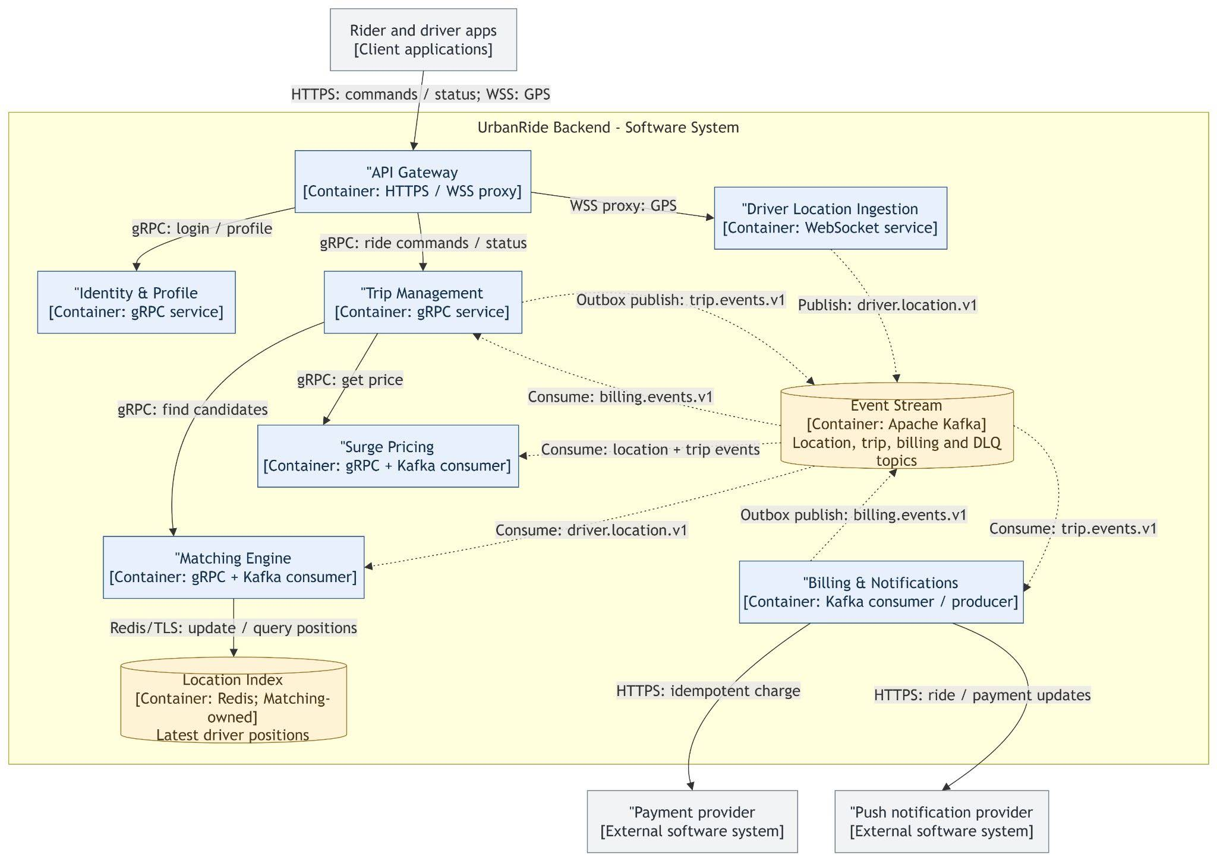
Five core services and two supporting services separate high-throughput ingestion from transactional workflows.
Boundary Principle
Split driven by the 625× gap between GPS ingestion and ride requests.
Core Services
Trip Management
Driver Location Ingestion
Matching Engine
Surge Pricing
Billing & Notifications
Supporting Services
API Gateway
Identity & Profile

Slide 6
A hybrid Saga pattern ensures financial consistency across distributed services.
Phase 1 (Booking)
Synchronous Orchestration
Managed directly by Trip Management service to establish immediate locks and handle card authorizations.
Mechanism: Synchronous orchestration by Trip Management
Action: Lock fares and authorize cards
Phase 2 (Completion)
Asynchronous Choreography
Decoupled execution streaming through event-driven architecture to finalize transaction states.
Mechanism: Asynchronous choreography
Event Bus: Apache Kafka event stream
Reliability & Data Integrity
Reliability: Transactional outbox pattern and strict idempotency prevent double charges.

Slide 7
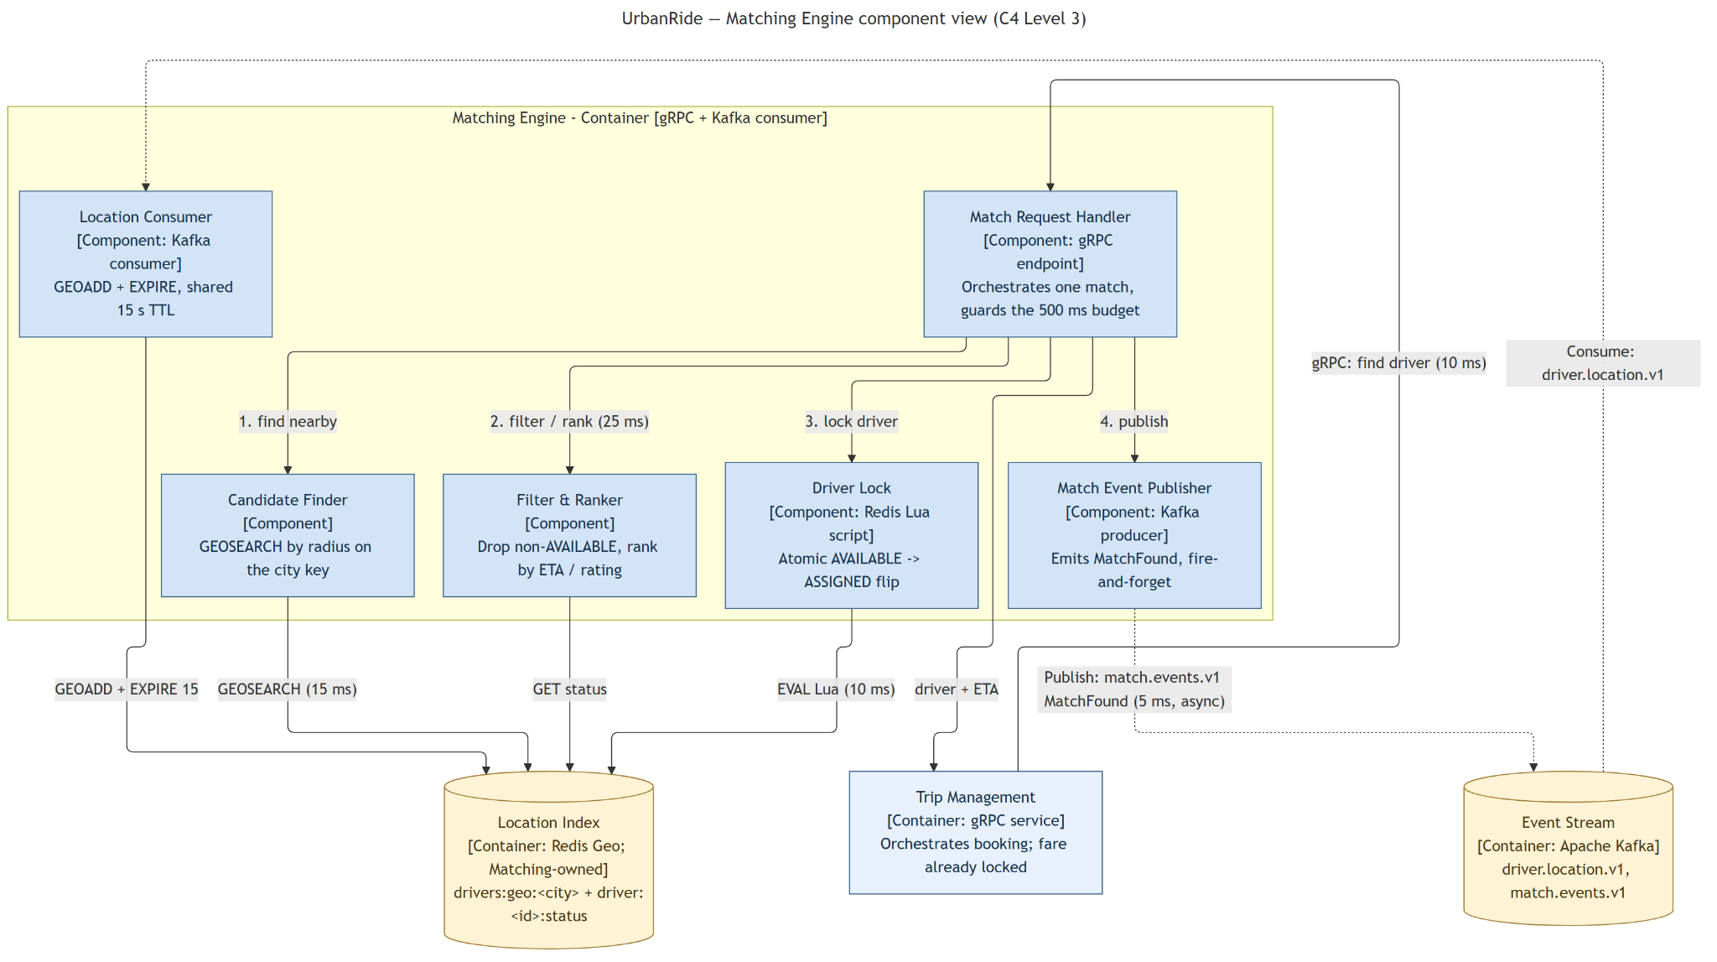
Redis Geo and atomic Lua locks ensure sub-500ms matching without double-booking.
HAPPY-PATH LATENCY BUDGET
155 ms
Total end-to-end execution latency for driver assignment
Speed: Designed for sub-500 ms matching, with a 155 ms happy-path latency budget using gRPC and internal pipelines.
Freshness: Redis Geo index continuously rebuilds every ~4 seconds directly from the Kafka driver location stream with a 15s TTL.
C4 LEVEL 3 ARCHITECTURE
The Matching Engine container handles location processing, candidate finding, ranker filtering, and driver locking within the 500ms strict latency budget.
Concurrency: Atomic check-and-set Redis Lua scripts execute state flips (AVAILABLE -> ASSIGNED) to prevent driver double-booking.

Slide 8
Kafka Decouples Heavy Write Traffic & Isolates Failures
Resilience (Debezium CDC):
Debezium CDC tails the Trip Management and Billing outbox logs and publishes events to Kafka; retries and consumer idempotency provide at-least-once processing.
BUFFERING CAPACITY
37,500
GPS pings / second
Stream safely processed through partitioned Kafka topics without persistent database load spikes.
Protection (Circuit Breakers):
Circuit breakers and adaptive rate limiters strictly protect the core synchronous request path from cascading upstream failures.
ARCHITECTURAL BOUNDARY & ISOLATION NOTE
Buffering: 37,500 GPS pings/s stream safely through Kafka partitions.
Resilience: Debezium CDC publishes outbox events to Kafka; retries and idempotency provide at-least-once processing.
Protection: Circuit breakers and rate limiters protect the core request path.

Slide 9
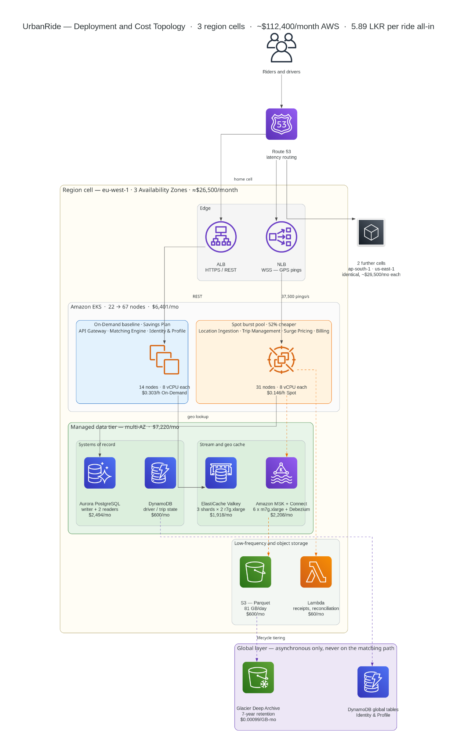
Three self-contained regional cells contain blast radius and ensure high availability.
Deployed across three distinct regional cells: ap-south-1, eu-west-1, and us-east-1.
Matching operations never cross cell boundaries, ensuring complete fault isolation and eliminating cross-region dependencies during active trips.
Stateless services dynamic capacity strategy leverages a hybrid topology, utilizing EC2 Spot capacity above a predictable On-Demand floor.
Architecture Guarantee
Blast Radius Containment: Complete regional failure limits impact to 33% of global traffic, maintaining uninterrupted service across remaining cells.

Slide 10
Cost engineering keeps infrastructure spend at 1.12 LKR per ride.
AWS Infrastructure
1.12 LKR (Spot compute, Graviton, S3 tiering)
Third-Party APIs
4.77 LKR (Maps, SMS, Push)
Total Spend Per Completed Ride
5.89 LKR
BUDGET EFFICIENCY & HEADROOM ANALYSIS
1.12 AWS
4.77 APIs
41% Headroom Remaining below the 10.00 LKR budget ceiling per ride.
Total spend of 5.89 LKR provides substantial operational margin, driven by aggressive spot compute optimization, Graviton architecture, and efficient S3 storage tiering.

Slide 11
Thank You
Q & A
Feel free to ask any questions

